Slide 1


PROJECT -Demo
Fall’18

Slide 2
Quick Demo & Stats !
Project’s
1.Completed a project in wide NLP Application.
2.completed a project at the intersection of vision & language.
3.Completed one project in collaboration with other members.
4.paper reading

Slide 3


PROJECT 1
1.Extracted data from Twitter using the tweepy API
2. Wrote a script to predict emotions and later-on classify them
3. Divide the data-sets into mini-batches which was later used during the training purpose
4.Robust models made using tensorflow and python

Slide 4
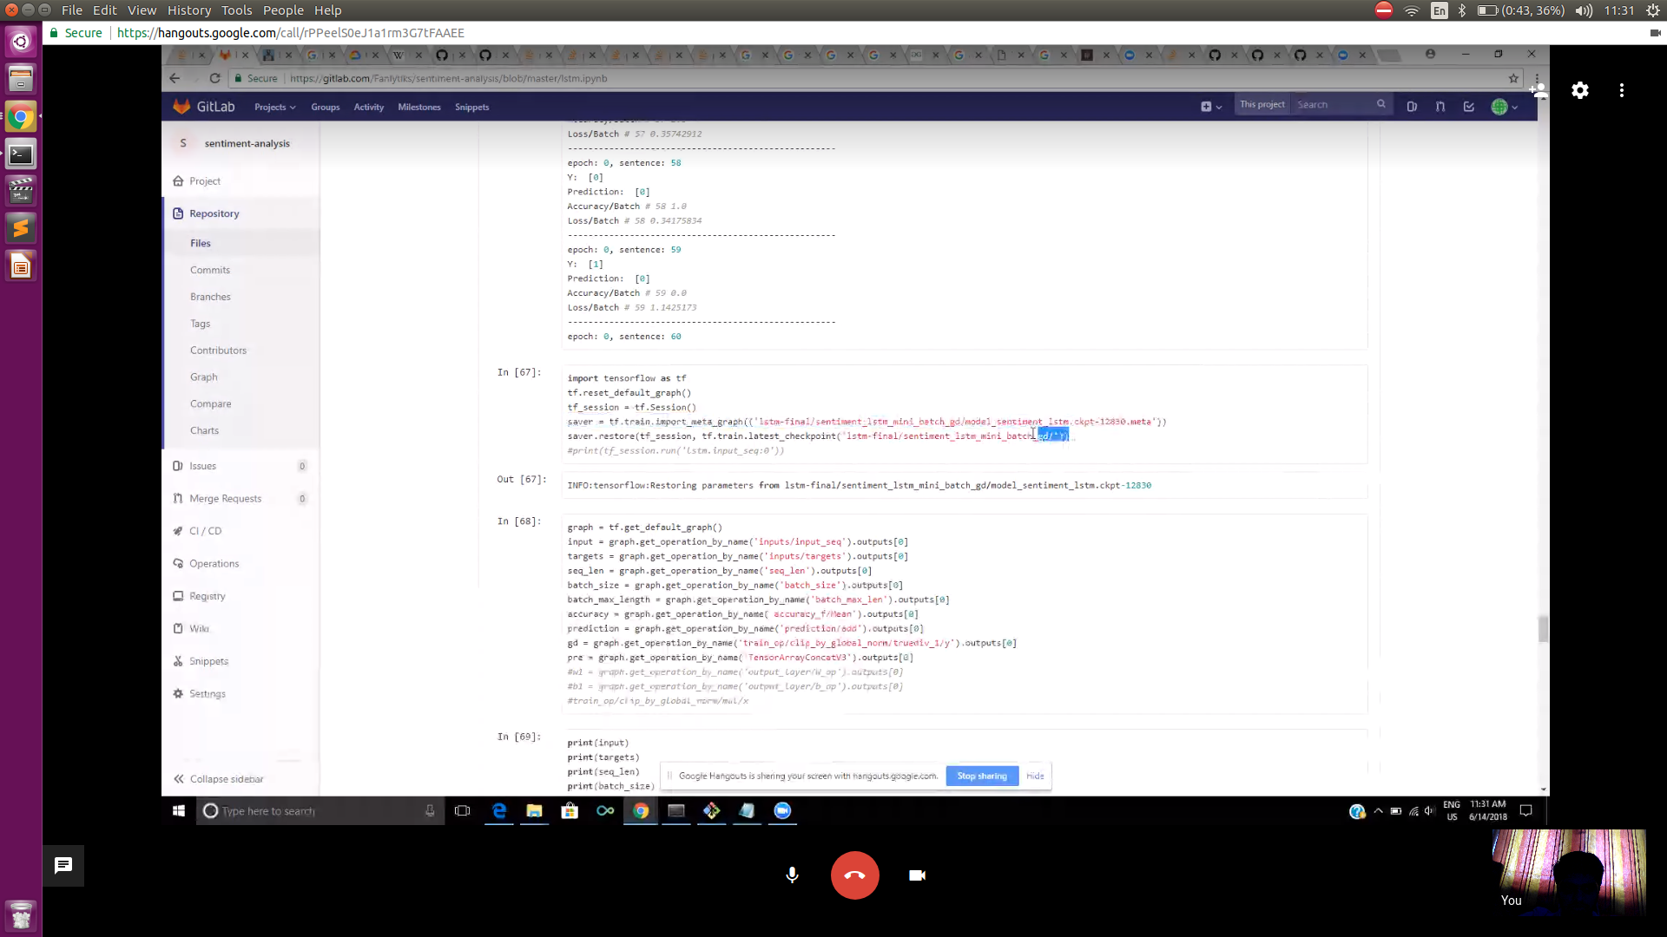

Slide 5
Project II
Show, Attend and Tell: Neural Image Caption Generation with Visual Attention - feb 2015
Kelvin Xu, Jimmy Ba, Ryan Kiros, Kyunghyun Cho, Aaron Courville, Ruslan Salakhutdinov, Richard Zemel, Yoshua Bengio
Top - down overview of state-of-the-art of deep-learning systems generate captions !

Slide 6
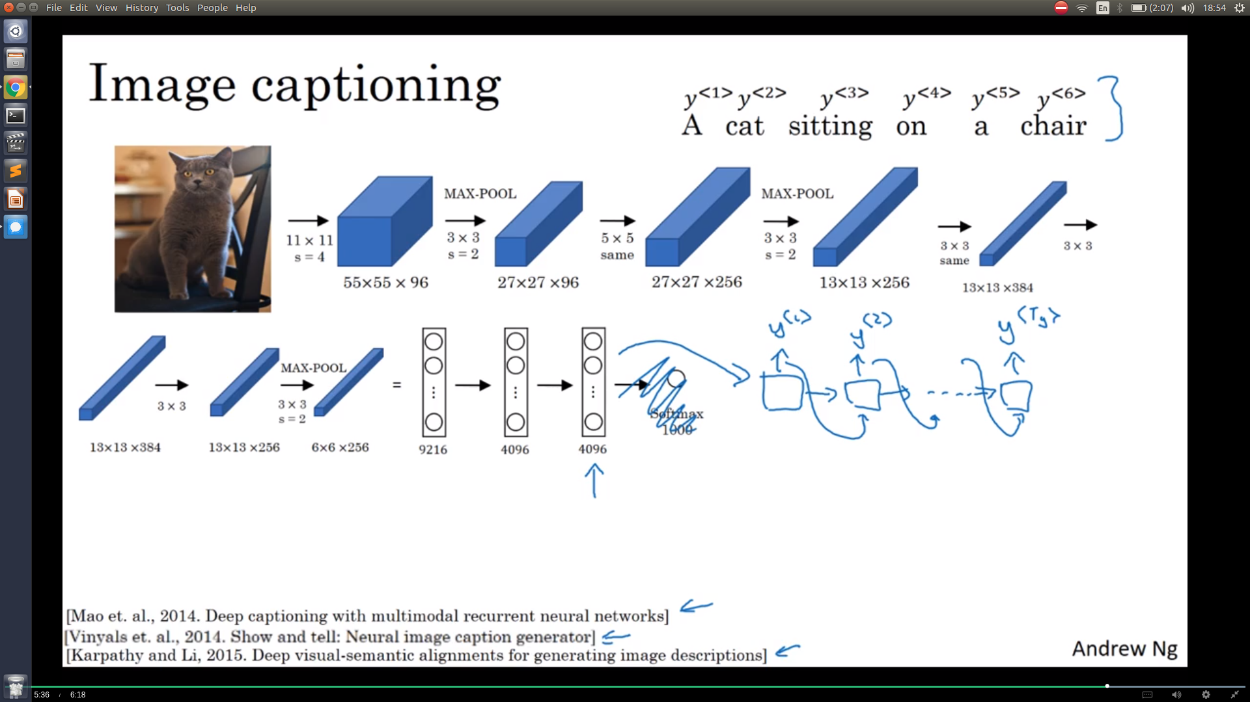

Slide 7
Lots of Image captioning models exists
Img2txt by google ai research
Neural talk 2 by karpathy
Baby neural captioning by georgia tech & fair
Show-attend-&-tell by UNIV MONTREAl
Captionbot.ai by msfrt research

Slide 8
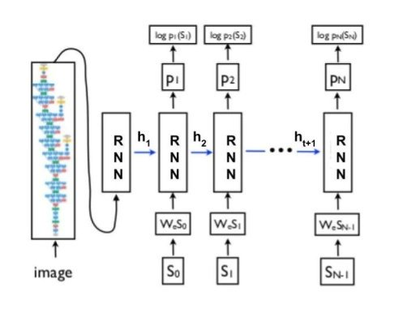
He recently moved from Spain to a

Slide 9
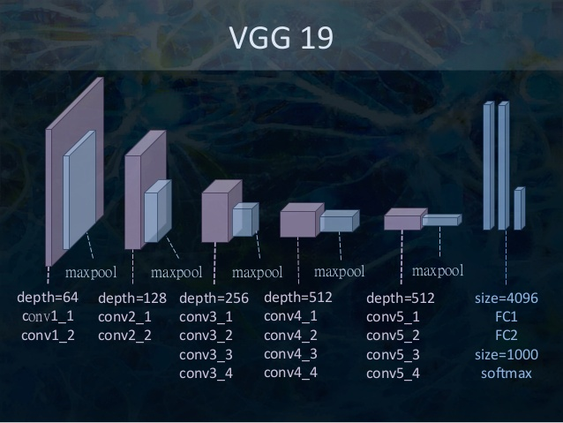

Slide 10
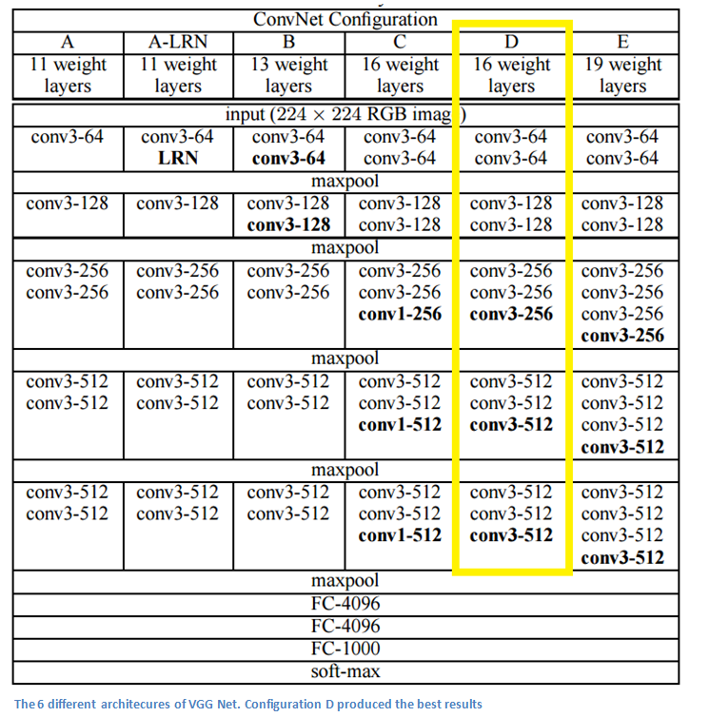

Slide 11
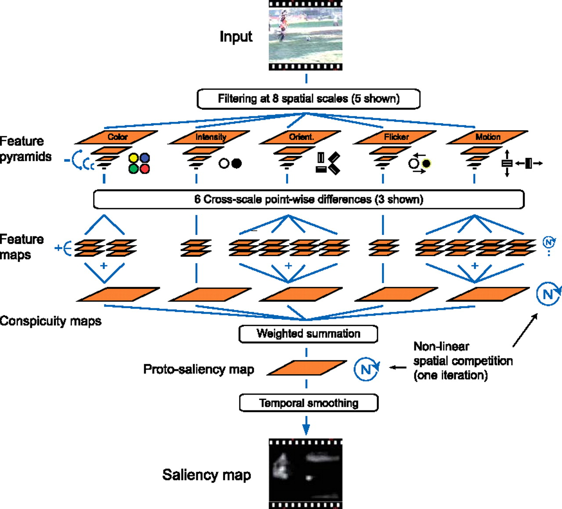

Slide 12
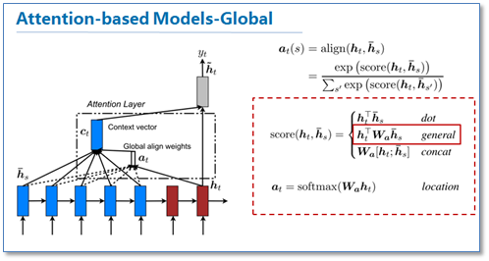
Attention mechanism is used to mimic human behaviour performances

Slide 13
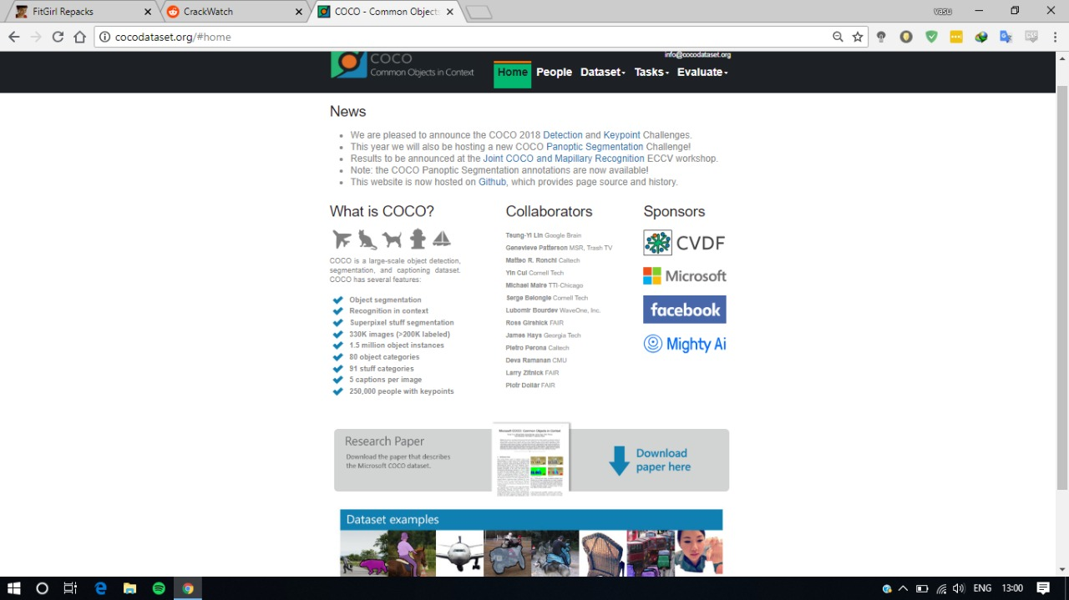

Slide 14
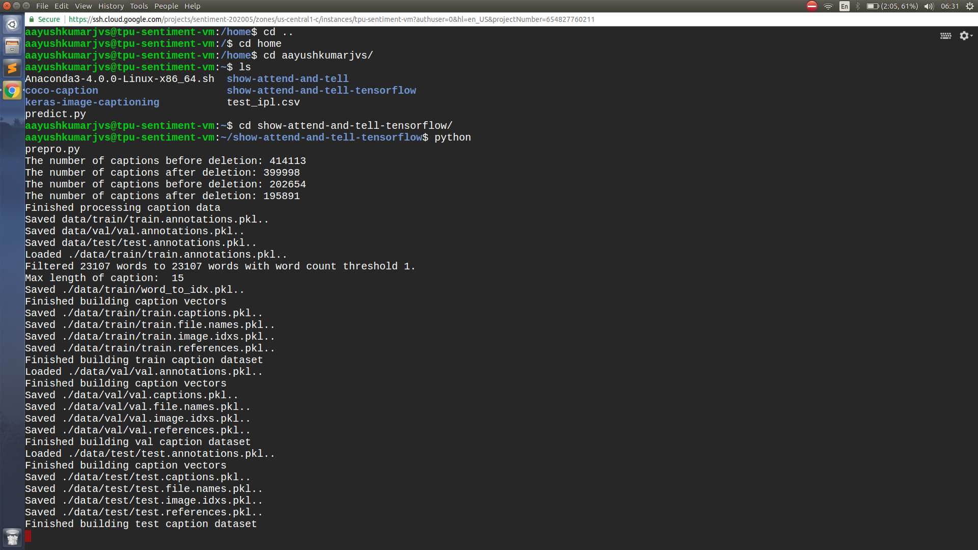

Slide 15
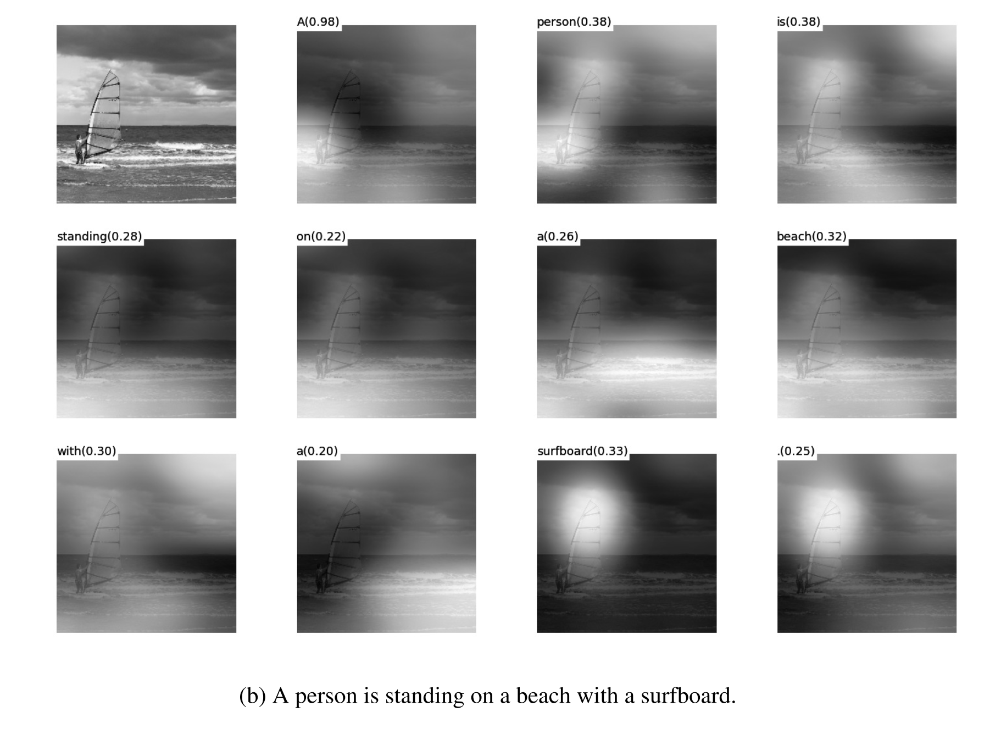
Captioning with visual attention

Slide 16
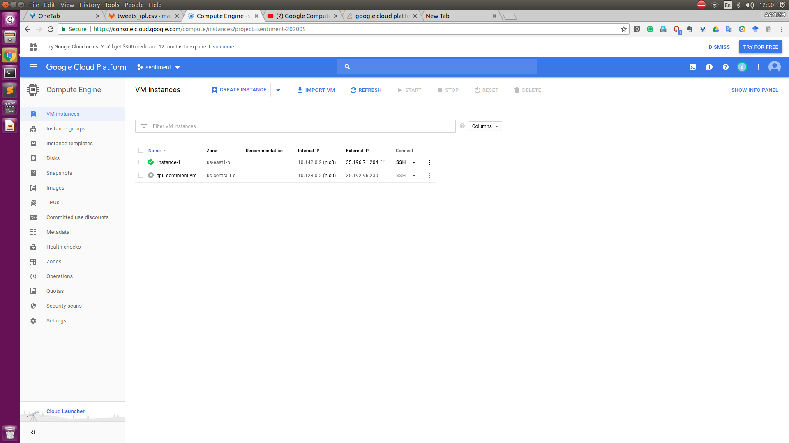
It’s no surprise Marcos uses Google Translate in his shop regularly.
There are 23 officially recognized languages in the EU.
Tip
Don’t let data stand alone. Always relate it back to a story you’ve already told, in this case, Marco’s shop.
Source: theguardian.com

Slide 17
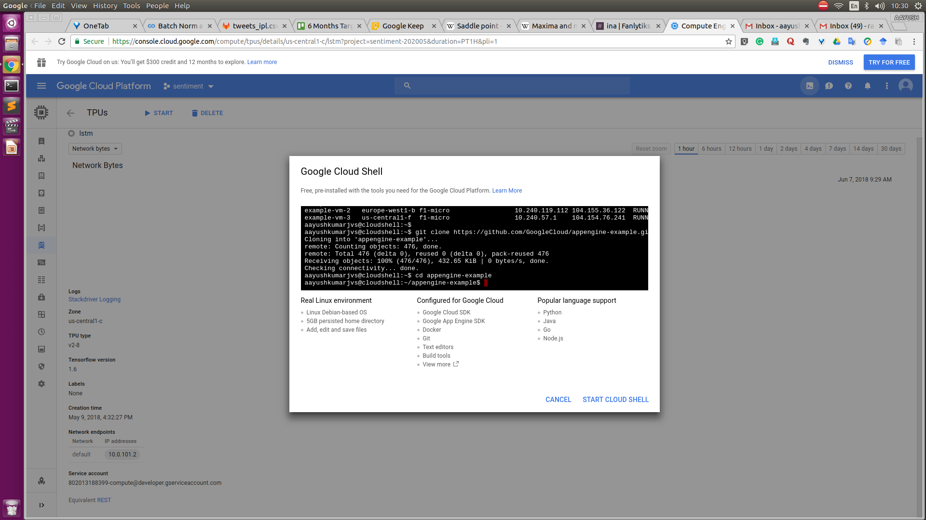


More than 50 million Americans travelled abroad in 2015
THAT’S MORE THAN THE POPULATION OF
CALIFORNIA AND TEXAS COMBINED
Tip
When a number is too large or too small to easily comprehend, clarify it with a comparison to something familiar.
Source: travel.trade.gov

Slide 18
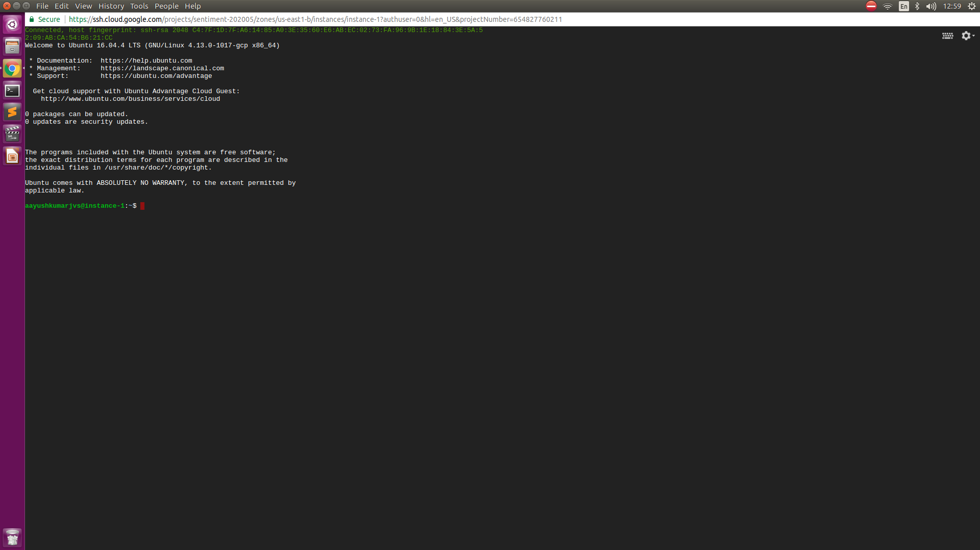
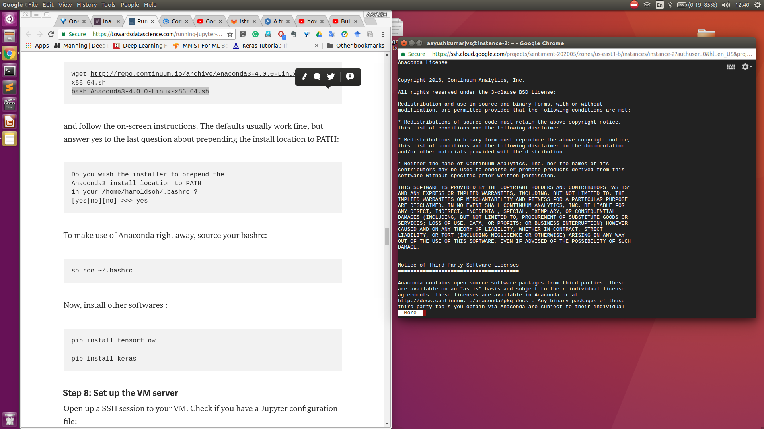
4. Closing
Build confidence around your product or idea by including at least one of the these slides:
Milestones What has been accomplished and what might be left to tackle?
Testimonials Who supports your idea (or doesn’t)?
What’s next? How can the audience get involved or find out more?

Slide 19
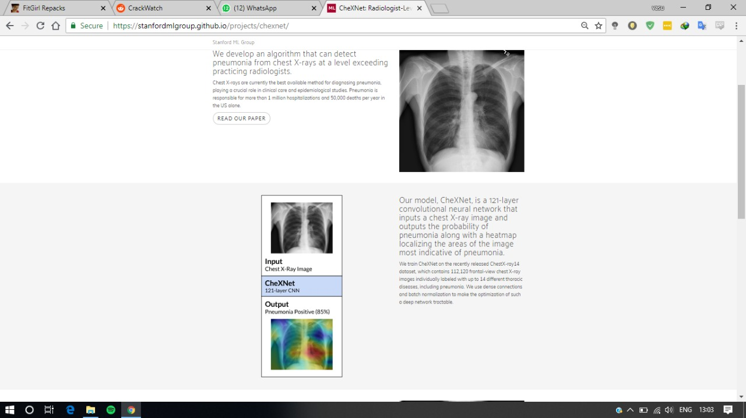

Good luck!
We hope you’ll use these tips to go out and deliver a memorable pitch for your product or service!
For more (free) presentation tips relevant to other types of messages, go to heathbrothers.com/presentations
For more about making your ideas stick with others, check out our book!

Slide 20
